Slide 1
Monthly Marketing Meeting
June 2024

Slide 2
Agenda
Review of last meetings actions.
Market trends and insights (intentionally broad topic, but anything interesting people have seen or learnt about that is worth sharing).
Current state of play across social media, influencers, PPC, newsletters, E-commerce, Branding, Content Creation (only to mention noteworthy items of discussion. Use this as a chance to showcase your particular area and provoke discussion).
START, STOP, DO MORE
Workload planning for upcoming month (does any particular function need support or is there as-hoc events that need greater focus e.g. ABF Festival)
Summarise actions for coming month (need to think of way to monitor these easily ....ideas welcome)

Slide 3
Actions from Prior Month
Paid Media
-
-
-
-
-
-
-
-
-
-
-
-
-
-
Content
-
-
-
-
-
-
-
-
-
-
-
-
-
-
Website/eCommerce
-
-
-
-
-
-
-
-
-
-
-
-
-
-

Slide 4
Market Trends & Insights
Competitor mentions, market mentions, ideas etc.

Slide 5
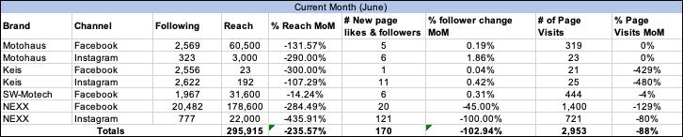
Social Media
What’s Worked Well
- 151% more Reach achieved on NEXX Traffic campaign MoM
- 120.99% (4.7k) increase on outbound clicks MoM through Paid Social campaigns
-
-
-
-
-
-
- -
Next Steps
-
-
-
-
-
-
-
-
-
-

Slide 6
Social Media Performance
Brand | Channel | Following | Reach | % Reach MoM | # New page likes & followers | % follower change MoM | # of Page Visits | % Page Visits MoM
 | Brand | Channel | Following | Reach | % Reach MoM | # New page likes & followers | % follower change MoM | # of Page Visits
 | Motohaus | Facebook | 2569 | 60500.00% | -1.315702479338843 | 5.00% | 0.001946282600233554 | 319.00%
 | Motohaus | Instagram | 323 | 3000.00% | -2.9 | 6.00% | 0.018575851393188854 | 23.00%
 | Keis | Facebook | 2556 | 23.00% | -3 | 1.00% | 0.0003912363067292645 | 21.00%
 | Keis | Instagram | 2622 | 192.00% | -1.0729166666666667 | 11.00% | 0.004195270785659802 | 25.00%
 | SW-Motech | Facebook | 1967 | 31600.00% | -0.14240506329113925 | 6.00% | 0.003050330452465684 | 444.00%
 | NEXX | Facebook | 20482 | 178600.00% | -2.844904815229563 | 20.00% | -0.45 | 1400.00%
 | NEXX | Instagram | 777 | 22000.00% | -4.359090909090909 | 121.00% | -1 | 721.00%
Totals |  |  |  |  | 295915 | -2.36% | 170 | -1.03%

Slide 7
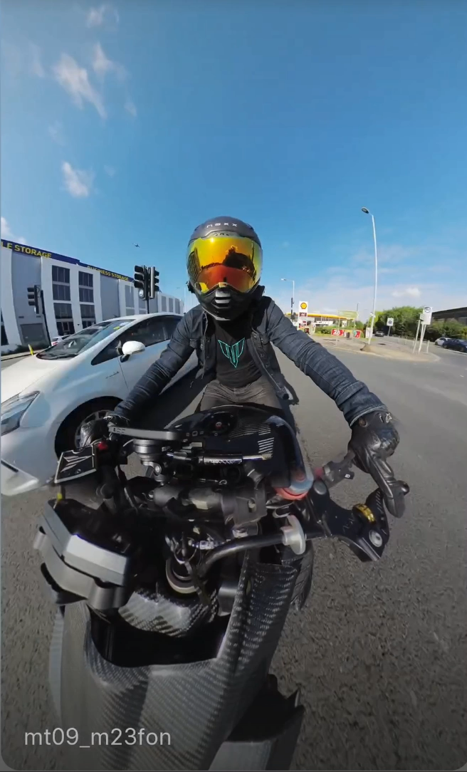
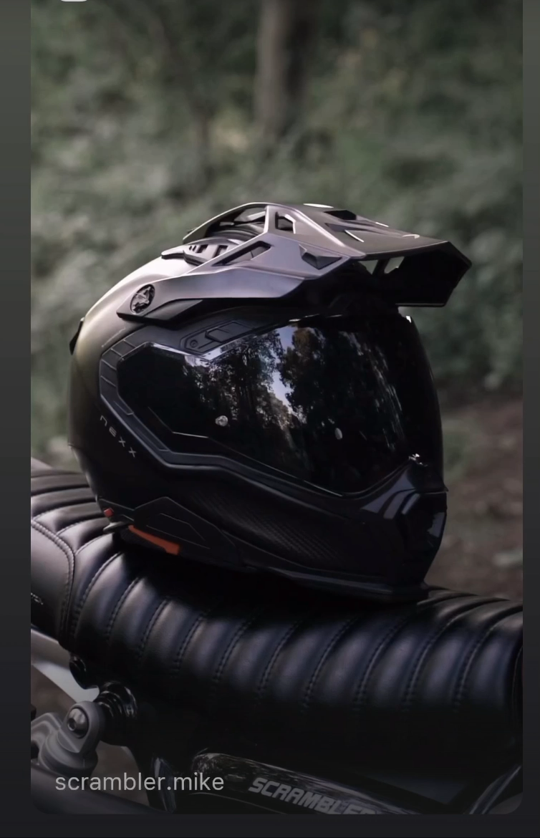
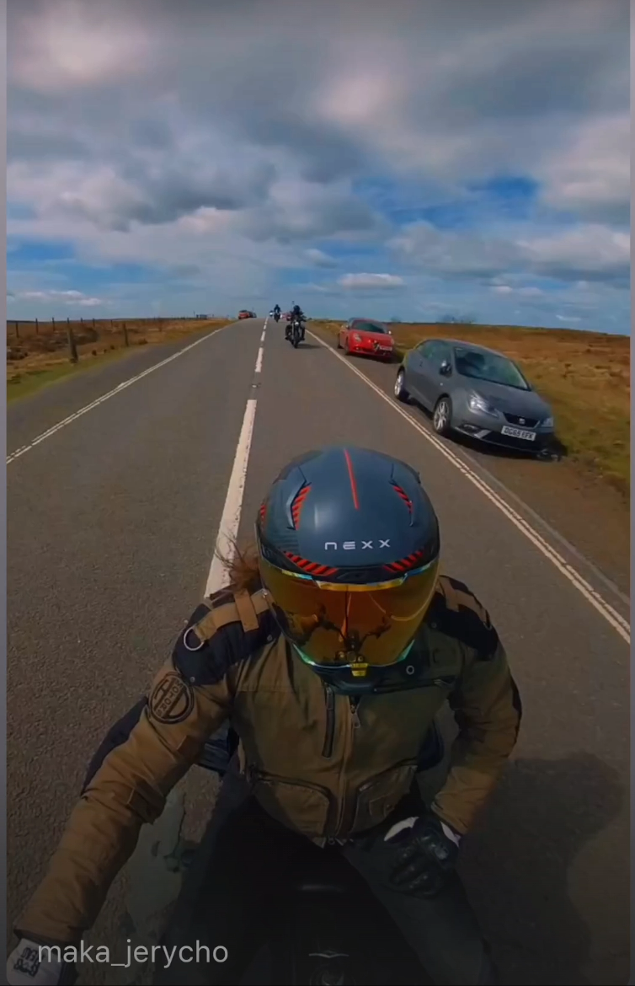
Influencer Activity
Wins, Improvements etc.

Slide 8
Paid Search
What’s Worked Well
- E.g., X ROAS
-
-
-
-
-
-
-
- -
Next Steps
- E.g., Creation of X campaign
-
-
-
-
-
-
-
-
-
Screenshot/summary of Data:

Slide 9
Newsletter/Email Activity
What’s Worked Well
- E.g., X ROAS
-
-
-
-
-
-
-
- -
Next Steps
- E.g., Creation of X campaign
-
-
-
-
-
-
-
-
-
Screenshot/summary of Data:

Slide 10
E-Commerce Updates
Wins, Improvements etc.

Slide 11
Start/Stop/Do More
START
-
-
-
-
-
-
-
-
-
-
-
-
-
-
STOP
-
-
-
-
-
-
-
-
-
-
-
-
-
-
DO MORE
-
-
-
-
-
-
-
-
-
-
-
-
-
-

Slide 12
Following Month Actions
Workload planning for upcoming month, does any particular function need support or is there as-hoc events that need greater focus e.g. ABR Festival)
Paid Media
-
-
-
-
-
-
-
-
-
-
-
-
-
-
Content
-
-
-
-
-
-
-
-
-
-
-
-
-
-
Website/eCommerce
-
-
-
-
-
-
-
-
-
-
-
-
-
-

